Slide 1

ICU DYNAMICS FROM MIMIC III DATA BY: J. Rice (JR76683)

Slide 2
Intensive care unit visits
Intensive Care Units are critical facilities to support effective healthcare
We examine how often these resources are used by patients in the full MIMIC III dataset
After that evaluation, we will dig deeper into what happens with patients who visit ICUs more frequently

Slide 3
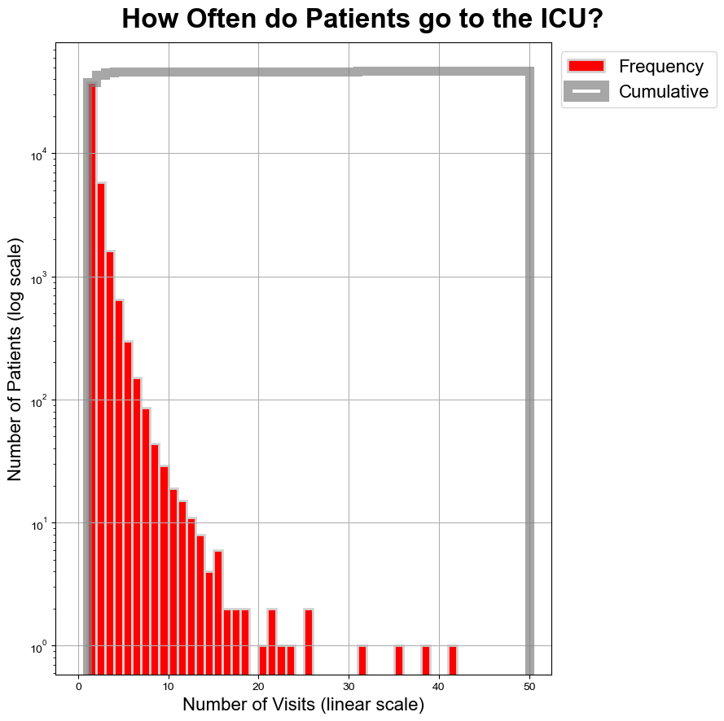
ICU Visit Frequency
We look at how often patients go to the ICU
Of the patients who visit the ICU at least once, the majority only have 1 or 2 visits
However, some patients have dozens of visits; we will examine patients who are visiting the ICU more than 10 times in the dataset
This histogram is built by grouping by SUBJECT ID in the ICUSTAYS table, taking a count of ROW ID by SUBJECT ID and then binning those counts by 1s

Slide 4
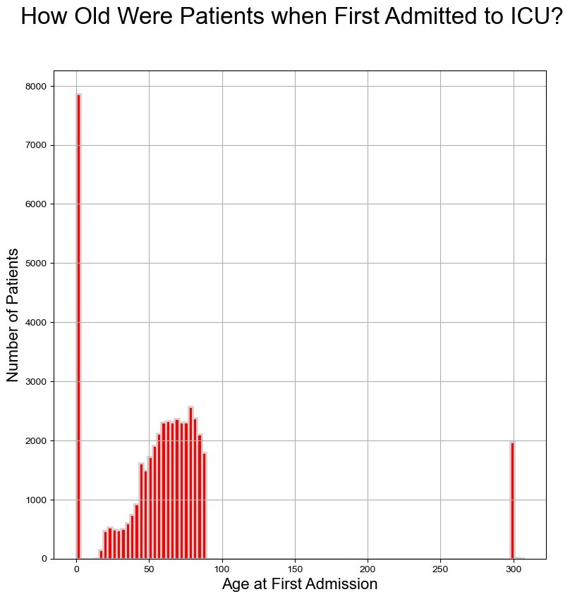
AGE AT FIRST ADMISSION
We look at the distribution of the ages of patients when they visited the ICU for the first time
We see two spikes, one early in life and one at “age” 300:
The early in life visits are exclusively NICU visits
The age 300 are patients whose ages were greater than 89 and those were masked to help preserve anonymity per the documentation
HOW TO?
This is generated by grouping by SUBJECT ID from the ICUSTAYS table and taking the first ICU INTIME for each subject.
We then subtract the SUBJECT ID DOB from the SUBJECT table from the INTIME in the previous step
We create 100 bins, chosen by matplotlib .hist function
NICU Visits
Patient Age > 89

Slide 5
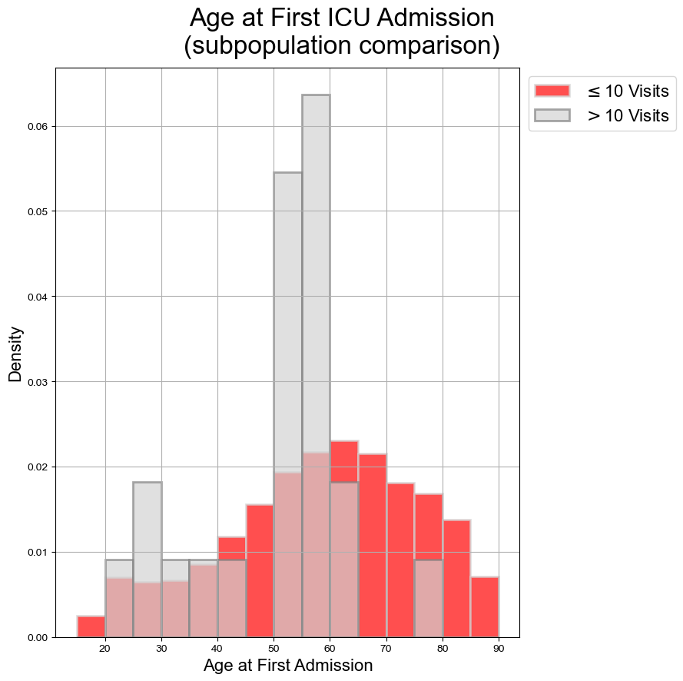
Age at first admission comparison
We are curious if there is a difference in age profiles between
For this analysis, we ignore NICU visits and only look at patients who are still alive in the dataset
We note some spikes in the 25–30-year-old, 50-55-, and 55–60-year-old bins
HOW TO?
We filter SUBJECT IDs whose DOD value is NA from the SUBJECT table
We then filter using the visit counts from previous steps to make the two populations to compare
We make bins from 15 to 95, by 5s (15-20, 20-25, …)

Slide 6
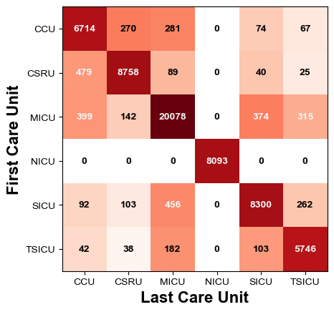
SINGLE ICU PER VISIT?
When admitted to the ICU, how often do patients leave from the same ICU from which they were admitted?
As expected, most of the time, patients leave from the same ICU that they are admitted
We note that for NICUs, patients are exclusively discharged from the NICU when admitted to the NICU, which is probably expected
Since patients move around, can we see what happens to them between the admitted ICU and discharged ICU?
HOW TO?
Using the ICUSTAYS table, we pivot the data by FIRST_CAREUNIT and LAST_CAREUNIT, counting each instance
We use .imshow to show these results and add text value labels by iterating through the array

Slide 7
STAY DURATION by visit number
On the following slide, we examine how duration lengths vary with visit number by a patient
Do patients that go more often require more time? Or are these visits for targeted reasons, so durations tend to be shorter?
For the analysis, we clip visit lengths at 14 days, and we normalize by visit number
For the avoidance of doubt, that means that the frequencies for each visit number add to 1 and sum of the array is the same as its shape in the visit number axis
HOW TO?
We assign a visit number for each stay in ICUSTAY by SUBJECT ID using .cumcount
For each of these visit counts, we then take the LOS
Using numpy.histogram2d, we get the frequencies for days of stay and visit number, with the former being clipped at 14 days
Using numpy, we normalize by the visit number axis
We plot using .imshow

Slide 8
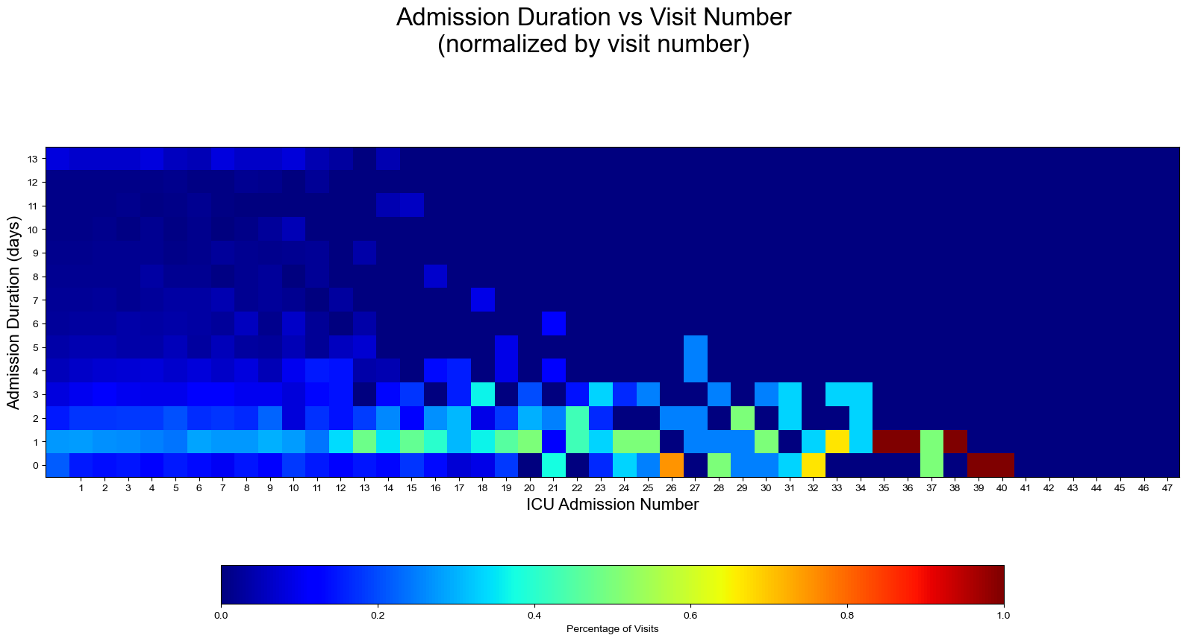
STAY DURATION by visit number

Slide 9
Frequent visitor ADMISSION patterns
From the first admission by high frequency visitors (>10 visits in dataset), what is the timing of the visits for the following 10 years from the first admissions?
We examine if these are grouped together or sporadic on the following slide
You will see both sporadic and concentrated visits
The x-axis is set such that each patients’ first visit starts at 0 years
The width of each bar is proportional to the stay duration
HOW TO?
To build the following, we normalize by the first admission INDATE by SUBJECT from the ICUSTAYS table
All other visits have their dates oriented from the previous
Width of each bar is calculated based on the difference between OUTTIME and INTIME, dropping NAs, if applicable
We use .hbars to indicate the duration of each visit, with a minimum width to ensure visibility

Slide 10
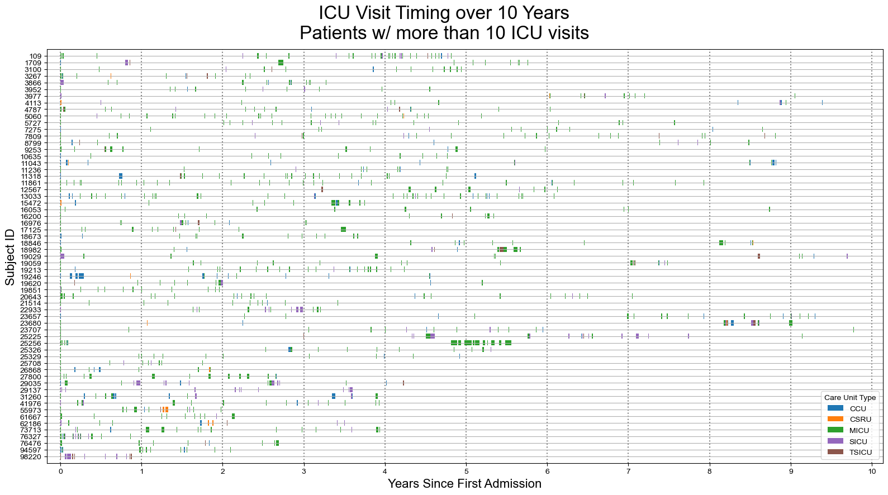

Slide 11
What happens once admitted?
For the high frequency visitors, we examine the transfer patterns using a network diagram
We will see if there are any interesting patterns between the high frequency visitors and the rest of the population
HOW TO?
Using the TRANSFERS table, we create a dictionary of dictionaries to see the current state and next state.
The first record for a stay always has a current state of “ADMISSION”, the next state is the ICU if not NA else “OTHER WARD”
Subsequent records follow the previous convention depending on the presence or absence of the CURR_CAREUNIT
The final record for a stay also used the convention for the current state, but the next state is always “DISCHARGED”
For each combination, we instantiate if it doesn’t yet exist to 1 and if it does exist, increment the value by 1
We then build a network map using the networkx package and the showing the result in circulate form, to help intepretability

Slide 12
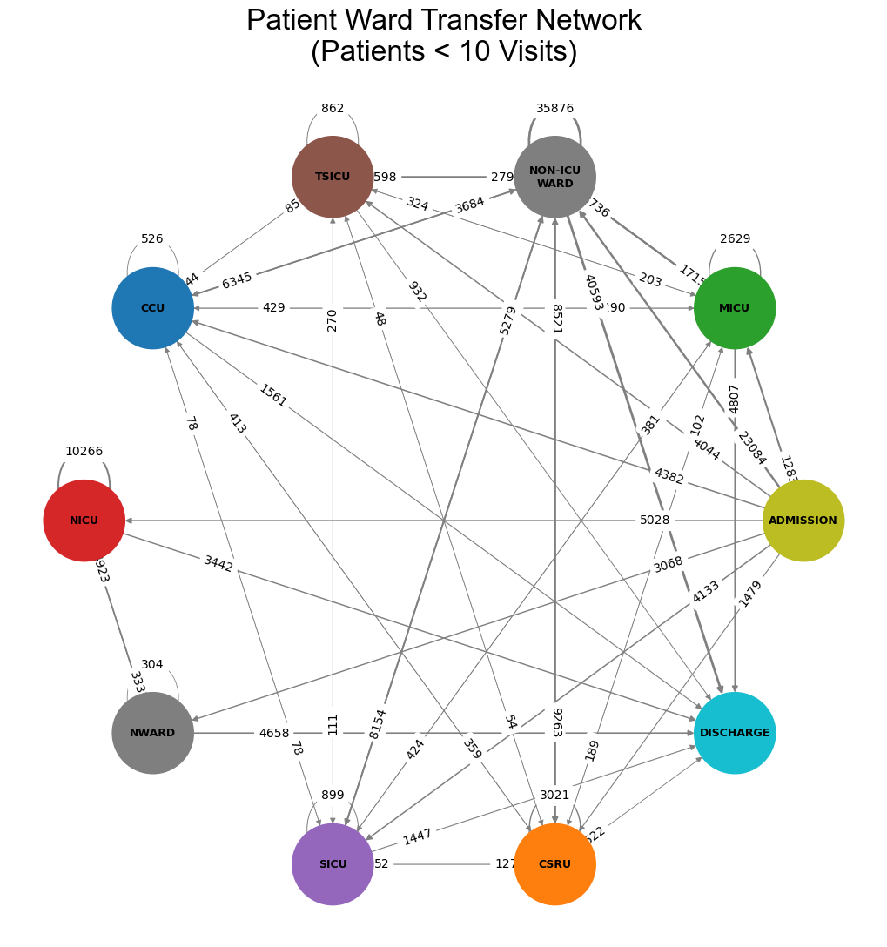
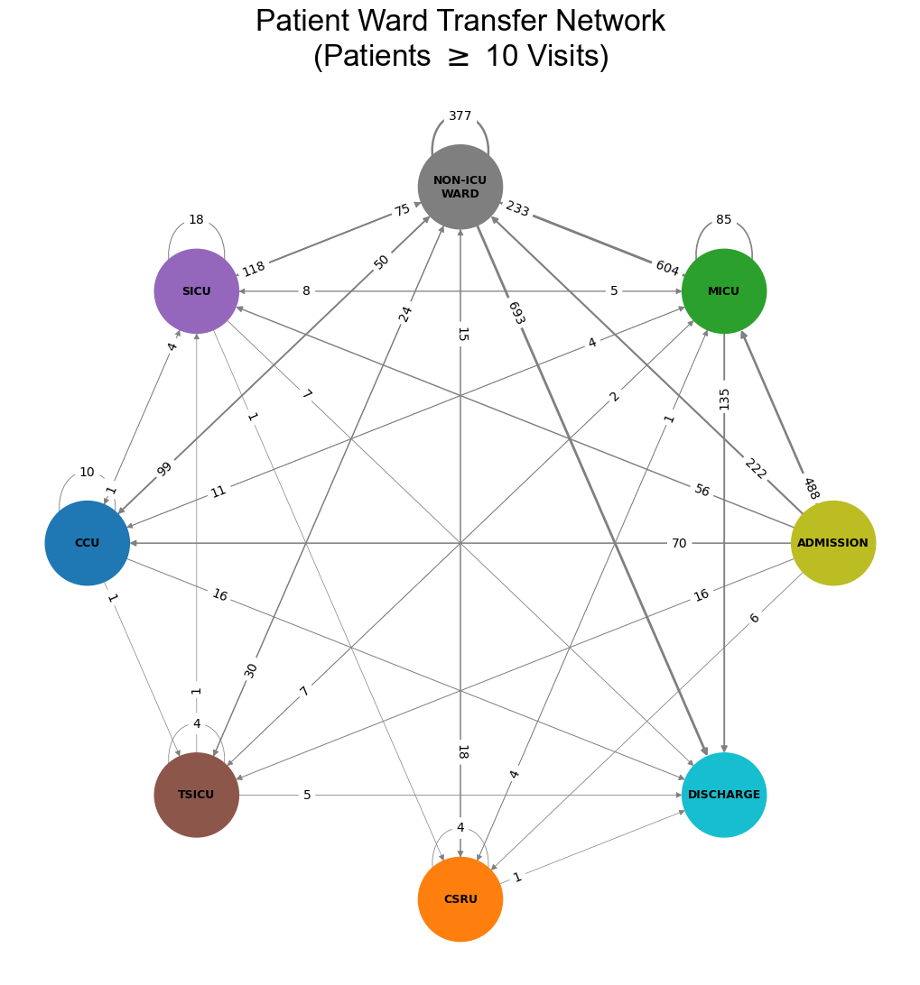

Slide 13
FINAL comments
There appear to be several interesting observations that were noted; more research could be performed to see if there are any commonalities in cohorts that have experience one way or another for ICU frequency
It would be especially interesting to try to figure out the reasons for the spikes in the 25-30 age bin and 50-60 age bins
These patterns may be interesting to study to see if there are systemic issues that could potentially be avoided to improve patient health outcomes

